Slide 1
Kehelland Reading Information Evening

Slide 3
What we will discuss:
The big picture – why is reading important?
How we teach reading at key stage two.
Shared reading/VIPERS.
Accelerated reader.
Expectations for home reading.
Any questions….

Slide 4
Why?
Over the last two decades, there has been a deepening recognition of the fundamental importance of improving reading standards on a child’s future academic achievement, wellbeing and success in life. Reading, alongside proficient language development, is the key to unlocking the rest of the academic curriculum. (DfE reading framework, 2021)

Slide 5
Cressida Cowell
‘Opening a book for the very first time still fills me with the same excitement and anticipation that it did as a child. Books enable children to discover new worlds, meet new people and learn about the past, but they also have the power to transform lives. By sparking growing imaginations, stimulating critical thinking and helping to develop empathy, reading gives children the very skills they need to succeed at school, at work and in life’.

Slide 6
Who or what made you read for pleasure?

Slide 7
How we teach reading at key stage 2
The programmes of study for reading consist of 2 dimensions:
word reading
comprehension
Our teaching focuses on developing pupils’ competence in both.

Slide 8
The National Curriculum

Slide 9
What are Vipers?

Slide 10
VIPERS is an acronym to aid the recall of the 6 reading domains as part of the UK’s reading curriculum. They are the key areas which we feel children need to know and understand in order to improve their comprehension of texts.

Slide 11
Whole Class and Group Reading
In KS2, the children all take part in a daily reading lesson from 9.00 – 9.30. In these lessons, children work on developing their VIPERS reading skills.
Children read the text.
The 6 domains focus on the comprehension aspect of reading and not the mechanics.
Children work individually, in pairs, groups and as a whole class during these sessions.

Slide 12
Reading Fluency and Expression Reading fluency and expression is part of the planned sequence of learning.

Slide 13
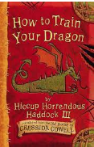
Reading for pleasure
All classes read together in the afternoon. In Key stage two, children share a copy of the whole class text which is linked to our topics.

Slide 14
Desert Island Books!
You have been exiled to a desert island. You can only take three books. Which books would you take and why?

Slide 15
What else do we do to promote reading for pleasure?
We read in house groups where children enjoy sharing books with a reading buddy in mixed age pairs.
Children take part in a weekly reading assembly.
We have arranged virtual and real visits by authors.
We take part in national reading events like World Book Day and The Summer Reading Challenge.

Slide 16
Why Role Models for Reading are so important.
‘I write my How to Train Your Dragon and The Wizards of Once books to be read aloud, because books read to you in your parents’ voice live with you and send an important message: books are important; books are powerful, magical things that can make your dad cry or your mum laugh, and they contain the sort of wisdom in them that can change your life’. Cressida Cowell

Slide 17
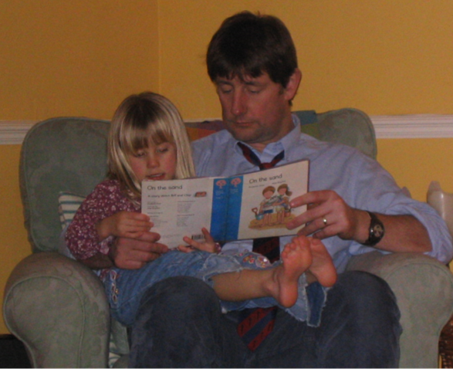

Slide 18
A Parent’s Guide to Star Reading and Accelerated Reader
What is Star Reading?
Star Reading is an online assessment used to determine a child’s English reading level.
It is a computer-based reading assessment program that uses computer-adaptive technology.
Questions continually adjust to each child’s responses. If the response is correct, the difficulty level is increased.
If they cannot answer a question, or answer incorrectly, the difficulty level is reduced.
The test uses multiple-choice questions and takes approximately 20-30 minutes.

Slide 19
What is Accelerated Reader
AR is a computer program that helps teachers manage and monitor a child’s independent reading practice. Children pick a book that falls within their ZPD level.
When they have finished reading, they take a short quiz on the computer - passing the quiz is an indication that the child has understood what has been read.
If they are reading at the recommended level for them, then most children are likely to be successful and enjoy the books and quizzes. Best of all they learn and grow at their own pace.

Slide 20
What is a ZPD (Zone of Proximal Development)?
A ZPD is the range of books that will challenge a child without causing frustration or loss of motivation.
Each child will receive a ZPD, or reading range, after taking a Star Reading test.
It is important for children to read with a high degree of comprehension and within their ZPD.

Slide 21
How can I help my child using Renaissance?
As with anything, reading and understanding English language improves with practice.
According to Renaissance research, children who read at least 20 minutes a day and achieve a 90% comprehension rate on AR quizzes see the greatest gains.
Encourage your child to read at home, discuss books, and ask questions about what they have read.

Slide 22
Reading VIPERS Question Stems KS2 All children will be given a booklet with question stems to help with discussions about reading at home.

Slide 23
What are Interest levels & points?
Every book that has an AR quiz is assigned an Interest Level to identify which age group a book is appropriate for, based on the content and themes within the book.
Each AR quizzed book also has a point value calculated to denote the length & time of the reading experience.
AR points are based on the length of the book (number of words).
Pupils earn a percentage of points according to how well they pass the quiz.

Slide 24
How do we monitor and reward progress?
Each teacher will look at a weekly report and monitor reading frequency and how well children are reading within their ZPD level.
The children will work through different certification levels and be presented with these in our celebration assembly.
We also monitor individual and class word counts which is shared with children.
Class favourite reads are also shared and displayed.

Slide 25
What are our favourites in Trevose, Tater Du and Longships?

Slide 26
The children will decide on what the reward for joining this club might be!

Slide 27
What books do you think all children should read?

Slide 28
Recommended Book Lists
https://www.booksfortopics.com/ks2

Slide 29
Other ways to access books and encourage reading at home.
https://www.borrowbox.com/

Slide 30
Why is it still important to read and discuss books with our fluent readers in upper key stage 2?
https://www.youtube.com/watch?v=n1EGzKtR9DE

