Slide 1
Phonics and reading at Kehelland Village School
phonics

Slide 3
https://www.youtube.com/watch?v=sjlPILhk7bQ

Slide 4
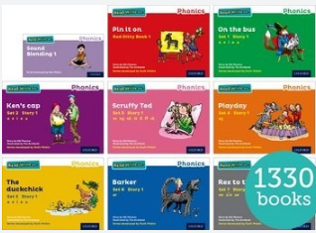
Why the change?
The UK government has stipulated that schools should use a single systematic Phonics scheme, and not to take pick and mix elements from different schemes. “Cherry picking”, as mixing different schemes has been described, can be successful, but it can also lead to problems, with children confused or being presented with reading material that is too easy or too difficult for them. By following the Read Write Inc scheme, we can ensure that your children are learning to read in a systematic way, taking home books exactly matched to their current phonic skills. In this way, they feel success.
https://www.youtube.com/watch?v=bXOJUPNVnLc
Understanding Phonics

Slide 5
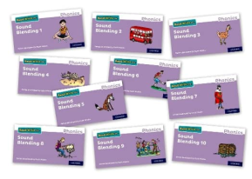
The reading journey
The children start by learning the Set 1 sounds- these are the 26 letters of the alphabet, plus some digraph sounds- special friends - sh, ch, th, qu, ng and nk. The programme moves quickly, with 4 or 5 single letter sounds introduced each week and then 2 or 3 digraph sounds each week. The children start learning the sounds as soon as they enter school, in order to get them reading as soon as possible. As you can see, it is really important that you practise the sounds with your child daily, in order to enable them to remember all the sounds. There are 74 to remember by the end of the programme, so this applies to all the children following the RWI scheme, whether in YR, Y1 or Y2.
Our current Pebbles have completed all the Set 1 sounds this week. They have read individual words in Sound Blending Books, and are now moving on to the Red Ditty Books- reading short phrases.
https://www.youtube.com/watch?v=QLXCVD_MVOg

Slide 6
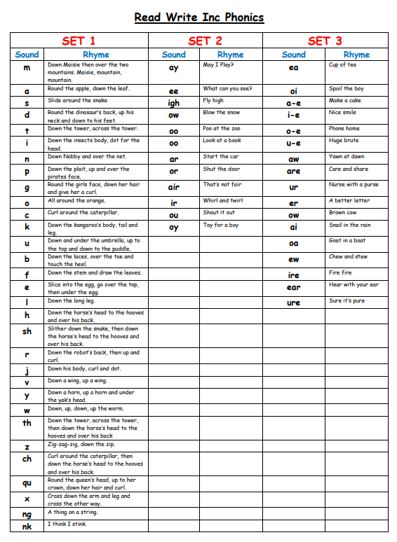
Sound | Rhyme
e-e | Go Pete and Steve
au | Paul the astronaut
ie | Terrible tie
ue | Come to the rescue
ph | Take a photo
wh | Whisk, whisk
ck | Tick tock
tion | Pay attention, it’s a celebration
tious cious | Scrumptious, delicious
e | He , me , she, we

Slide 7
What does a RWI word lesson look like?
Read Write Inc lessons take the form of Word time and Book time sessions, lasting about 40 minutes. Most days, we have both Word time and Book time. In the Word time session, the children learn a new sound, using the same routine of activities in each day. They read words containing that sound, then review words from previous lessons. Finally they write words containing the new sound, and also write review words containing previously learned sounds.
https://schools.ruthmiskin.com/training/view/oQ3mGZLi/F7nirFVu
https://schools.ruthmiskin.com/training/view/z6faCSvB/V3qXvPAh

Slide 8
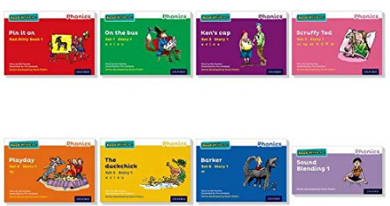
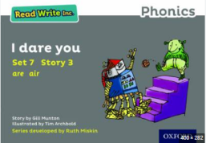
Book time
The Book time session follows immediately after the Word time lesson. The children will be reading a book in a group of children at a similar reading level as themselves. They will read it three times in school and then bring it home. The repetition enables them to read with some confidence, fluency and expression. It is best if you hear your child read this book as soon as they bring it home. (Thursday usually). If you leave it until after the weekend, they will have lost some of their confidence and fluency. We don’t expect you to listen to your child read it more than once, unless they really want to.

Slide 9
Prior to reading on Day 1, the children practise the focus sounds, the story green words, the speedy green words, and the red words as a group. They then practise the focus sounds, the story green words and the red words in pairs, before reading.
On Day 2, they practise the speedy green words and the red words before reading.
On Day 3, they listen to the teacher read the text with expression, discussing as a group why they are using that expression. The children then read the book one last time with their partner. At the end they answer comprehension questions about the book as a group- either retrieval questions, (Fastest Finger) or inference questions (Have a think). This leads into the VIPERS comprehension work that they will be doing once they have completed the scheme.
The children then bring the book home.

Slide 10
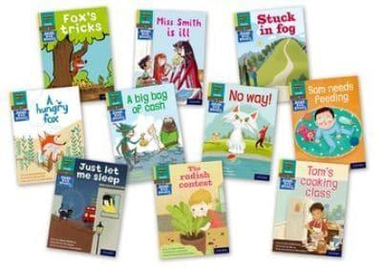
Book bag books
In addition to their school book, the children will be bringing home a “book bag book”. This may be a fiction book, in which case it is a different shape to the ones your child has been reading in their lesson, and had a brightly coloured illustration on the front cover. Alternatively, your child may bring home a non-fiction book. This looks similar to the school lesson book, but clearly says non-fiction on the front cover.
It is really important that you listen to your child read daily. In school, we no longer have the session from 9 until 9.30 when staff and parents would listen to your child read. This session is now taken up by the RWI session. In Class 1, we listen to your child read three times in the RWI lessons. We also aim to listen to the children read two or three times a week, especially the younger or less able readers. However, every child needs much more practice than this. We need you to support your child in this, in order for them to make progress and to keep up with their peers.

Slide 11
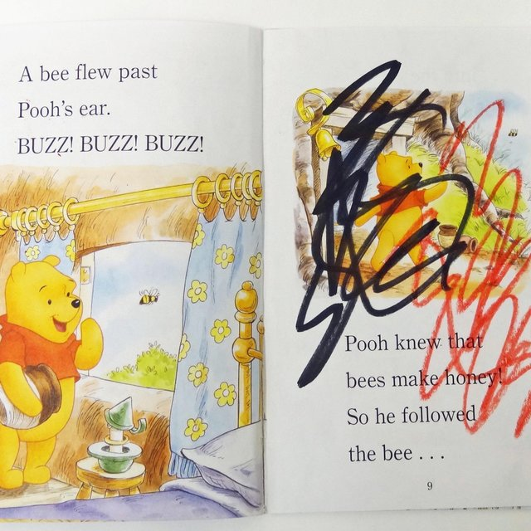
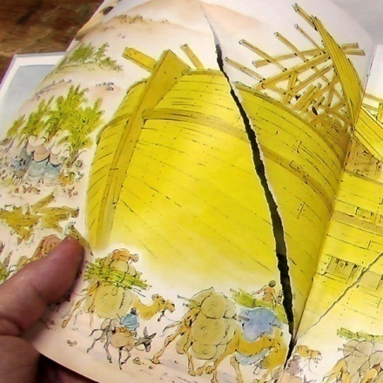
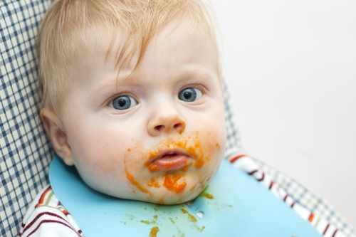
Looking after books
We are so lucky to have been able to replenish our school stock of reading books with the RWI books. They are colourful, well written and exactly matched to the children’s reading level. (In order to ensure this, we assess the children every half term on their letter sound knowledge and on the fluency of their reading). However, to purchase these books has cost the school a considerable amount of money and we cannot afford to buy replacements for damaged books. We teach the children to turn over the pages by holding the corner, not by using a swiping action. Please, please take care of the books when they are in your homes- beware of small children, food and pets! A few books have sadly been damaged already.

Slide 12
How you can help
- Go through the letter sounds daily with your child. RWI calls them Speed Sounds – your child needs to read them speedily and confidently. All children on the RWI programme need to practise. The more able readers can focus on the Set 3 sounds. This should take less than 2 minutes.
- Listen to your child read daily from either their Book Bag book, or on a Thursday, the book that they have been practising in school. This should take between 5 and 10 minutes at most.
- Read and share stories with your child daily. This is a relaxed time for you to spend with your child, but is hugely beneficial in terms of encouraging your child to develop a love of reading. Choose a time of day that fits in with your home routines. This story time can be as short or long as you and your child choose.
Some parents say that they do not have time to listen to their children read. We do appreciate that everyone has busy lives, but spending just 10 minutes with your child each day will make such a huge difference to their learning!
https://home.oxfordowl.co.uk/reading/reading-schemes-oxford-levels/read-write-inc-phonics-guide/
https://www.ruthmiskin.com/parents/

Slide 13
Moving on
Once children show that they know all 74 Speed Sounds, can read words containing these sounds correctly, and can read text with fluency (80–90+ words per minute), they will have completed the Read Write Inc programme. They will then move on the Accelerated Reader Scheme, which Mrs. Polglase will explain to you now…..
To finish
Lets read the words- Special friends, Fred talk, Read the word.
Thank you !

